Slide 1

USA’s state wise COVID 19 Data Analysis using
POWER BI

Slide 2

CONTENTS
AREA CHART……………………………………… 03
PIE CHART…………………………………………. 04
COLUMN CHART……………………………….. 05
LINE CHART……………………………………….. 06
BUBBLE CHART………………………………….. 07
HISTOGRAM………………………………………. 08
SCATTER PLOT……………………………………. 09
SCATTER PLOT……………………………………. 10
REFERENCE………………………………………… 11

Slide 3
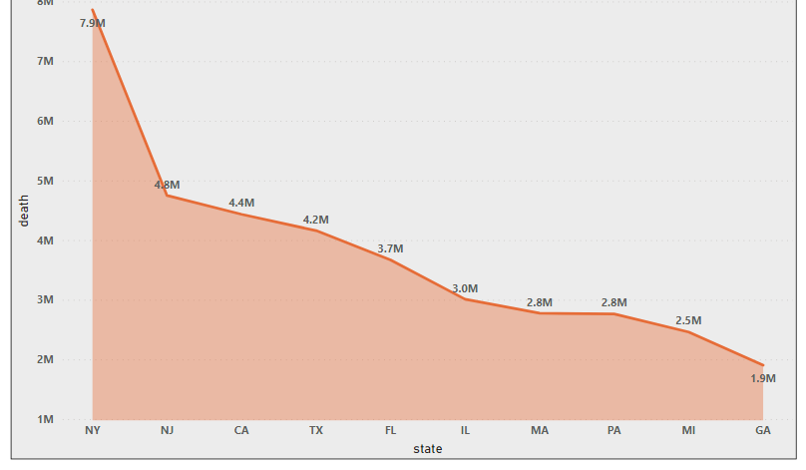
This graph is showing the top 10 states in US by deaths due to COVID.
The X axis is mapped to State and Y axis is mapped to Deaths
New York has the highest number of deaths.
Area chart is better than a Bar chart as Bar chart cannot effectively handle a large amount of data.
STACKED AREA CHART
It is primarily used when the trend needs to be shown with the magnitude rather than individual data values.

Slide 4
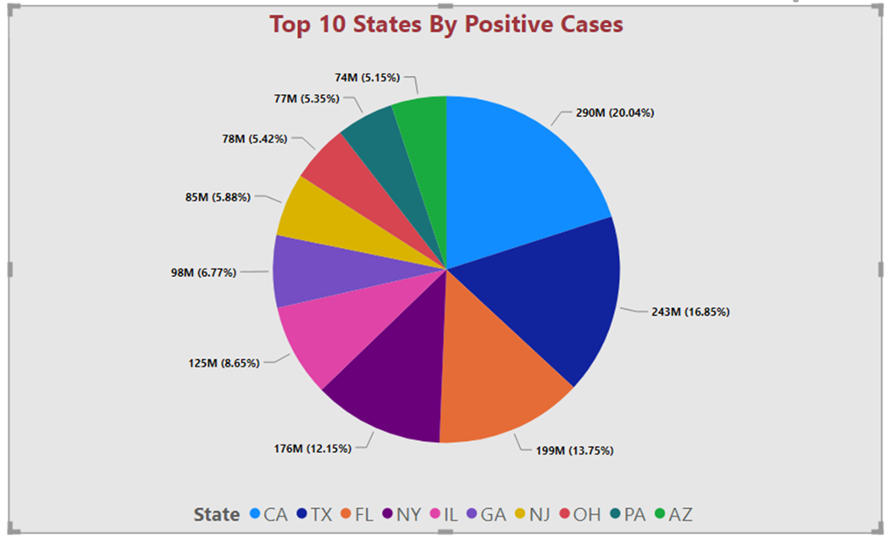
This chart is showing the top 10 states by Positive COVID cases in their region.
Each slice is representing a state.
CA has the highest number of cases followed by TX, FL, NY.
Pie chart is better than a Waterfall or tree map as it shows the relationship pf parts to a whole.
PIE CHART
Pie Chart is a round-shaped circle chart where each category data sets are shown in pie shape based on the value of each data label. Visuals are eye-catching and can convey the message better than the table

Slide 5
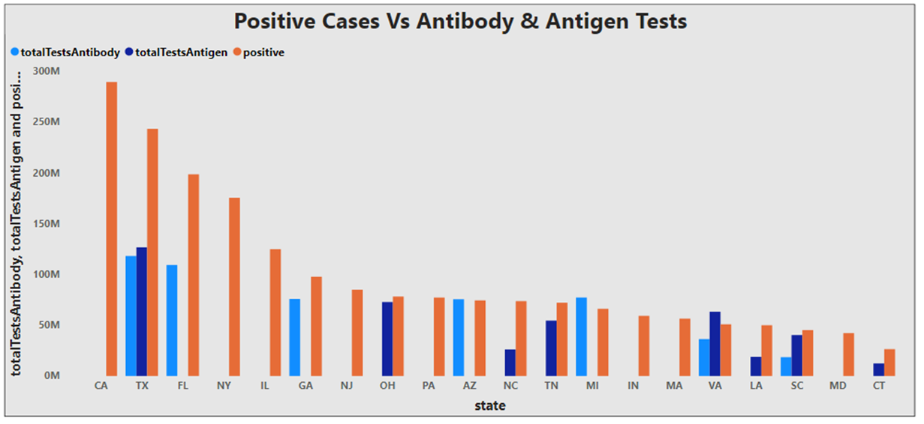
This chart is showing three different variables and their values state wise.
The X axis is mapped to sate
The Y axis is mapped to Positive cases, Antibody and Antigen.
Here, column chart is a better choice than embedded or Bar chart as it illustrates the correlation between two or more measures in one visualization.
COLUMN CHART
A clustered column chart displays more than one data series in clustered vertical columns. Each data series shares the same axis labels, so vertical bars are grouped by category.

Slide 6
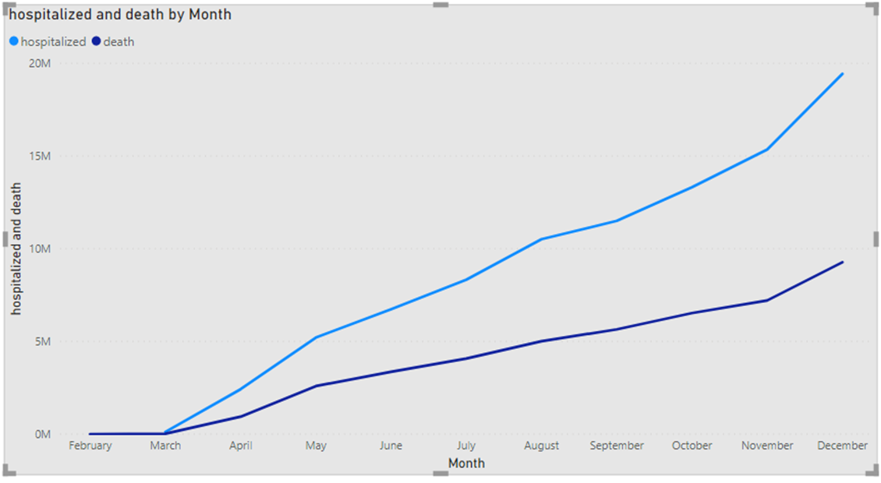
This chart is showing the increase in hospitalization and death by month.
The X axis is mapped to month
The two lines represents Hospitalization and Death.
The trend shows a increase in the number of deaths and hospitalization every month.
Here line chart is a better choice it helps illustrate a trend line which Bar graphs doesn’t.
LINE CHART
Line charts are a good way to show change or trends over time. In contrast to column or bar charts, line charts can handle more categories and more data points without becoming too cluttered.

Slide 7
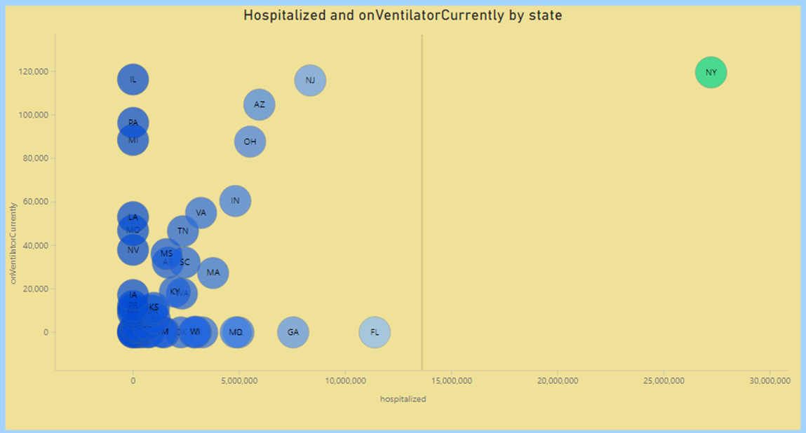
This chart is showing the relation between the hospitalized patients and the patients presently in Ventilators.
The third dimension used here is the state
The X axis is mapped to number of people Hospitalized and Y axis is mapped to Ventilator.
BUBBLE CHART
Can show the relationship of one variable to another
Unique ability to show data about a third dimension
Can visually display correlation

Slide 8
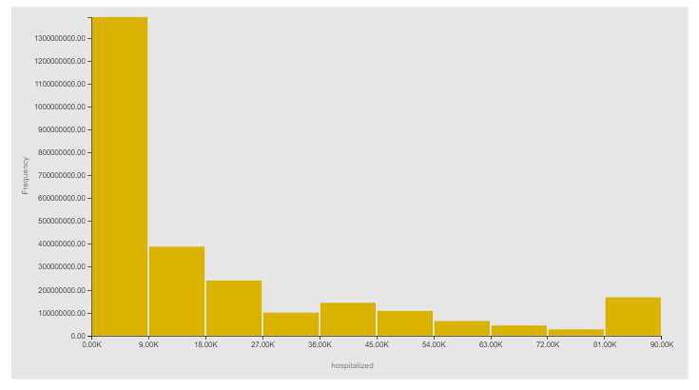
The X axis is mapped to number of people Hospitalized and Y axis is mapped to Positive cases.
The X axis represents the range, and the Y axis represents the frequency.
The range is set to 9k
HISTOGRAM
A histogram is a visual representation of the distribution of numerical data. It is a special kind of bar graph where bars represent "bins" that group together values at specific intervals.

Slide 9
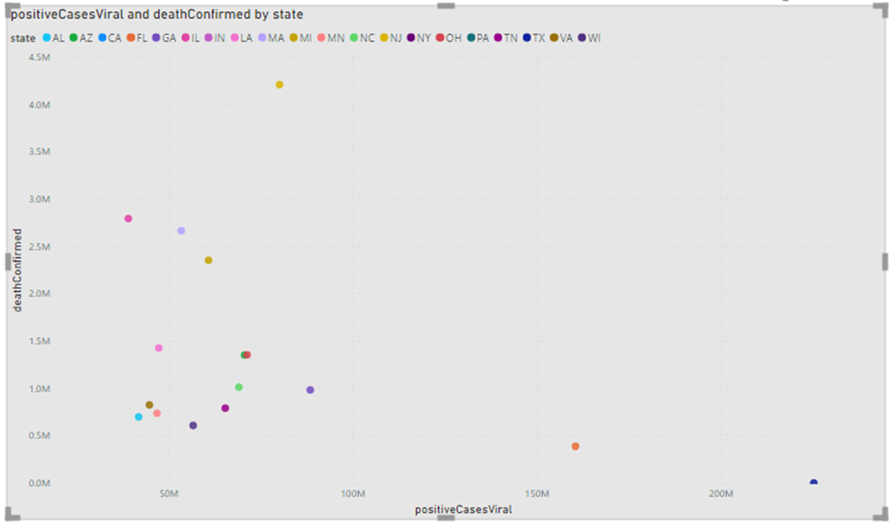
The X axis is mapped to positive cases Viral and Y axis is mapped to Death confirmed.
The data shows state wise number of total positive viral cases and the number of deaths.
NJ has the highest numbers of viral cases and deaths.
SCATTER PLOT
Can show the relationship of one variable to another
Visual display of correlation
Ideal for many types of scientific data

Slide 10
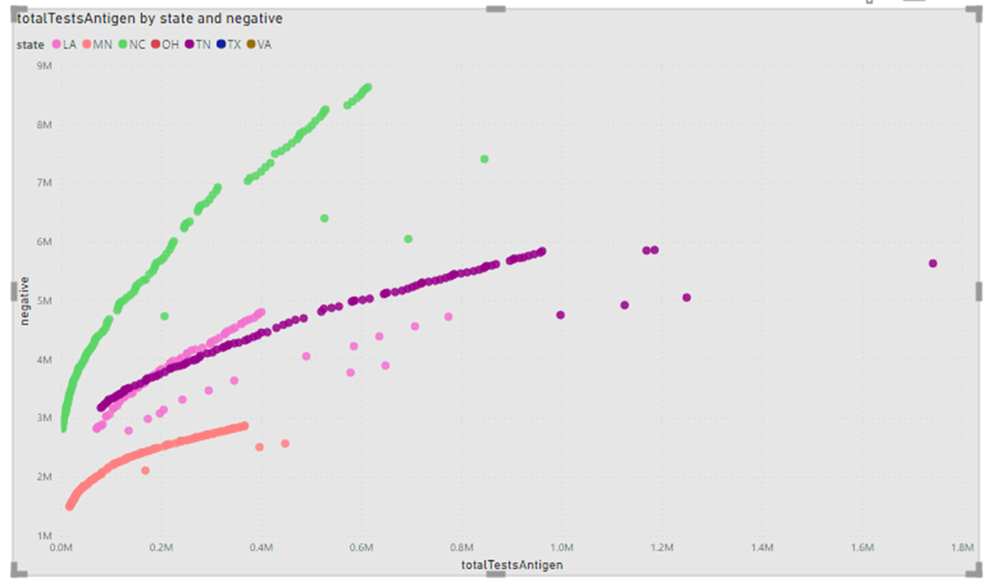
The X axis is mapped to total test antigen and Y axis is mapped to negative cases confirmed.
The graph shows a positive upward trend.
The data is shown state wise.
SCATTER PLOT
Can show the relationship of one variable to another
Visual display of correlation
Ideal for many types of scientific data

Slide 11

REFERENCE
https://covidtracking.com/data/download

Slide 12
Thank You

